Slide 1
Car Accident Severity Prediction
IBM Applied Data Science Capstone

Slide 2
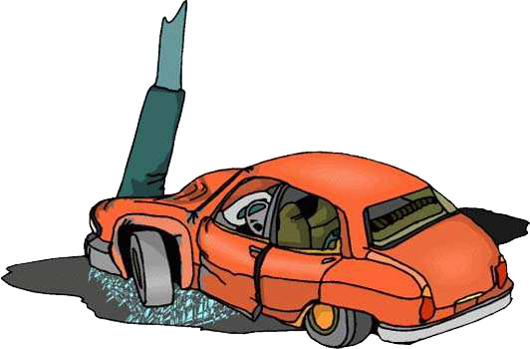
Introduction
Road accidents constitute a major problem in our societies around the world. The World Health Organization (WHO) estimated that 1.25 million deaths were related to road traffic injuries in the year 2010. For the year 2016, the USA alone had recorded 37, 461 motor vehicle crash-related deaths, averaging around 102 people per day. In Europe, the statistics also indicate that each minute, there are 50 road deaths recorded in the year 2017.
Can machine learning help us understand the causes and the factors that affect car crash severity?

Slide 3
Predicting Car Accident Severity is Very Important
Local government, police, rescue groups, and last but not least, car insurance institutes can get useful information from the model regarding the severity of an accident, to make insightful decisions for reducing the number of accidents and injuries.
In most cases, not paying enough attention during driving, abusing drugs and alcohol or driving at very high speed are the main causes of occurring accidents that can be prevented by enacting harsher regulations. Besides the aforementioned reasons, weather, visibility, or road conditions are the major uncontrollable factors that can be prevented by revealing hidden patterns in the data and announcing warning to the local government, police and drivers on the targeted roads.

Slide 4
Data Acquisition and Cleaning
Car accident severity data scraped from https://data-seattlecitygis.opendata.arcgis.com/datasets/5b5c745e0f1f48e7a53acec63a0022ab_0/data
The data consists of 39 independent variables and 221525 rows.
The dependent variable, “SEVERITYCODE”, contains codes that correspond to different levels of severity caused by an accident.
Cleaned data contains 13 features and the target variable.

Slide 5
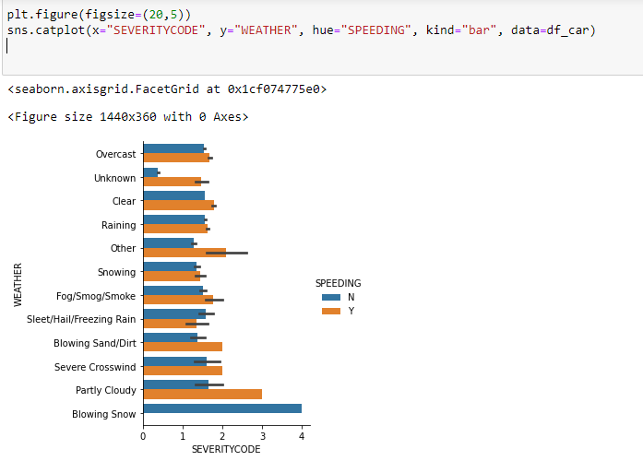
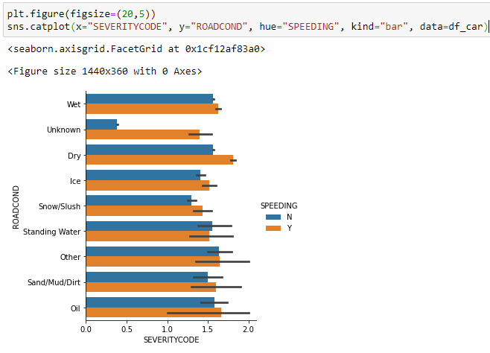
Exploratory Data Analysis
Catplot representing relation between different features.

Slide 6
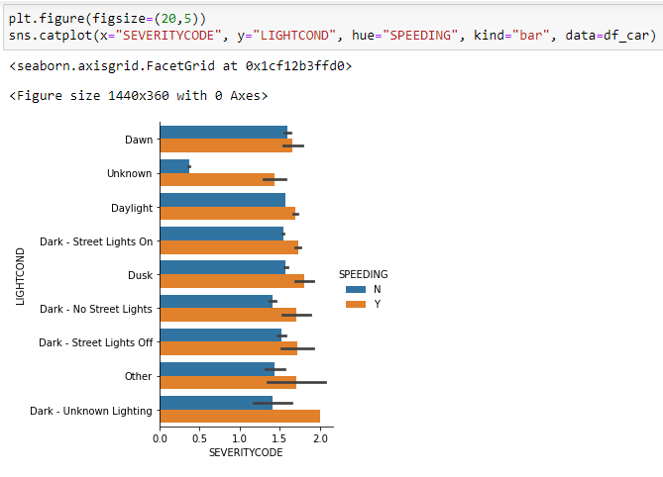
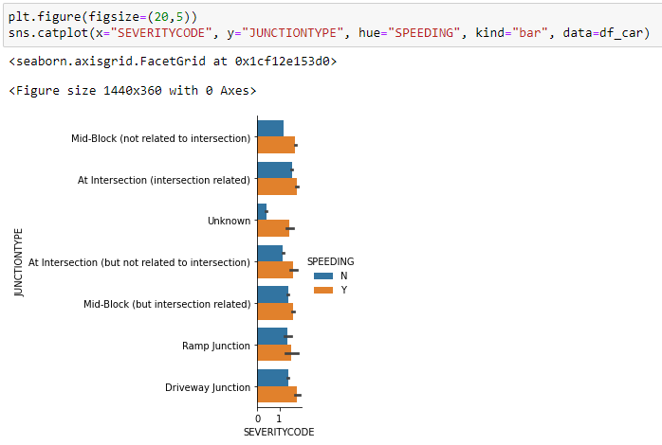
Exploratory Data Analysis (Contd..)
Catplot representing relation between different features

Slide 7
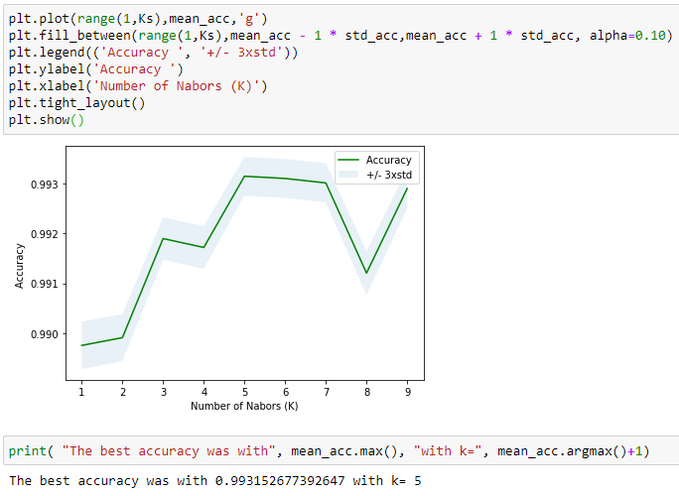
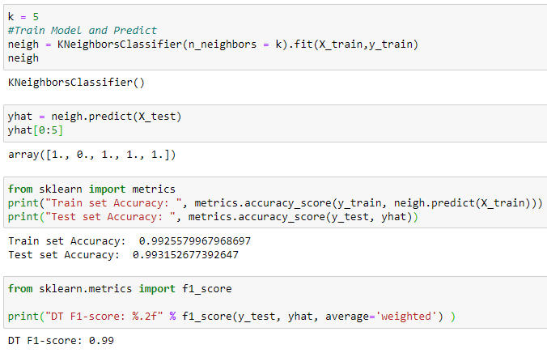
KNN Model to Predict Severity
KNN accuracy is best with K = 5
KNN accuracy: 0.993 and F1-Score : 0.99

Slide 8
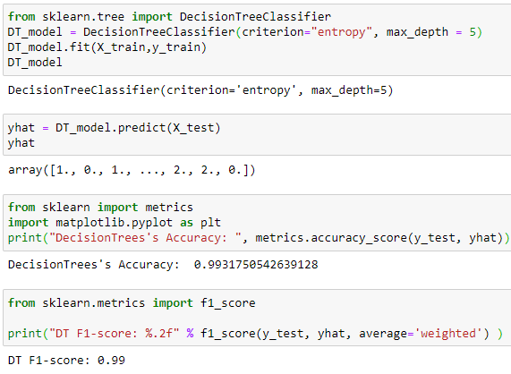
Decision Tree Model to Predict Severity
Decision Tree accuracy : 0.993
Decision Tree F1-Score: 0.99

Slide 9
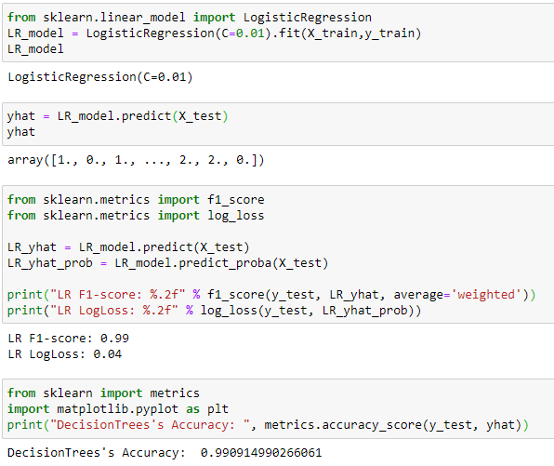
Logistic Regression Model to Predict Severity
Logistic Regression accuracy: 0.993
F1-Score : 0.99
Log Loss: 0.04

Slide 10
Results and Evaluations
ML Model | F1-Score | Accuracy | Log Loss
KNN | 0.99 | 0.993 | -
Desicion Tree | 0.99 | 0.993 | -
Logistic Regression | 0.99 | 0.990 | 0.004
Based on the dataset provided for this capstone from weather, road, light conditions, etc. pointing to certain classes, we can conclude that particular conditions have a somewhat impact on whether or not travel could result in property damage or injury.

Slide 11
Conclusion
Based on the dataset provided for this capstone from weather, road, light conditions, etc. pointing to certain classes, we can conclude that particular conditions have a somewhat impact on whether or not travel could result in property damage or injury. These models can be very helpful to reduce the economic and social impact of car accidents.

